Slide 1
Code Slayer
Tic Tac Toe Game
By Elvis, Axay, Luis, Stephanie, Nick

Slide 2
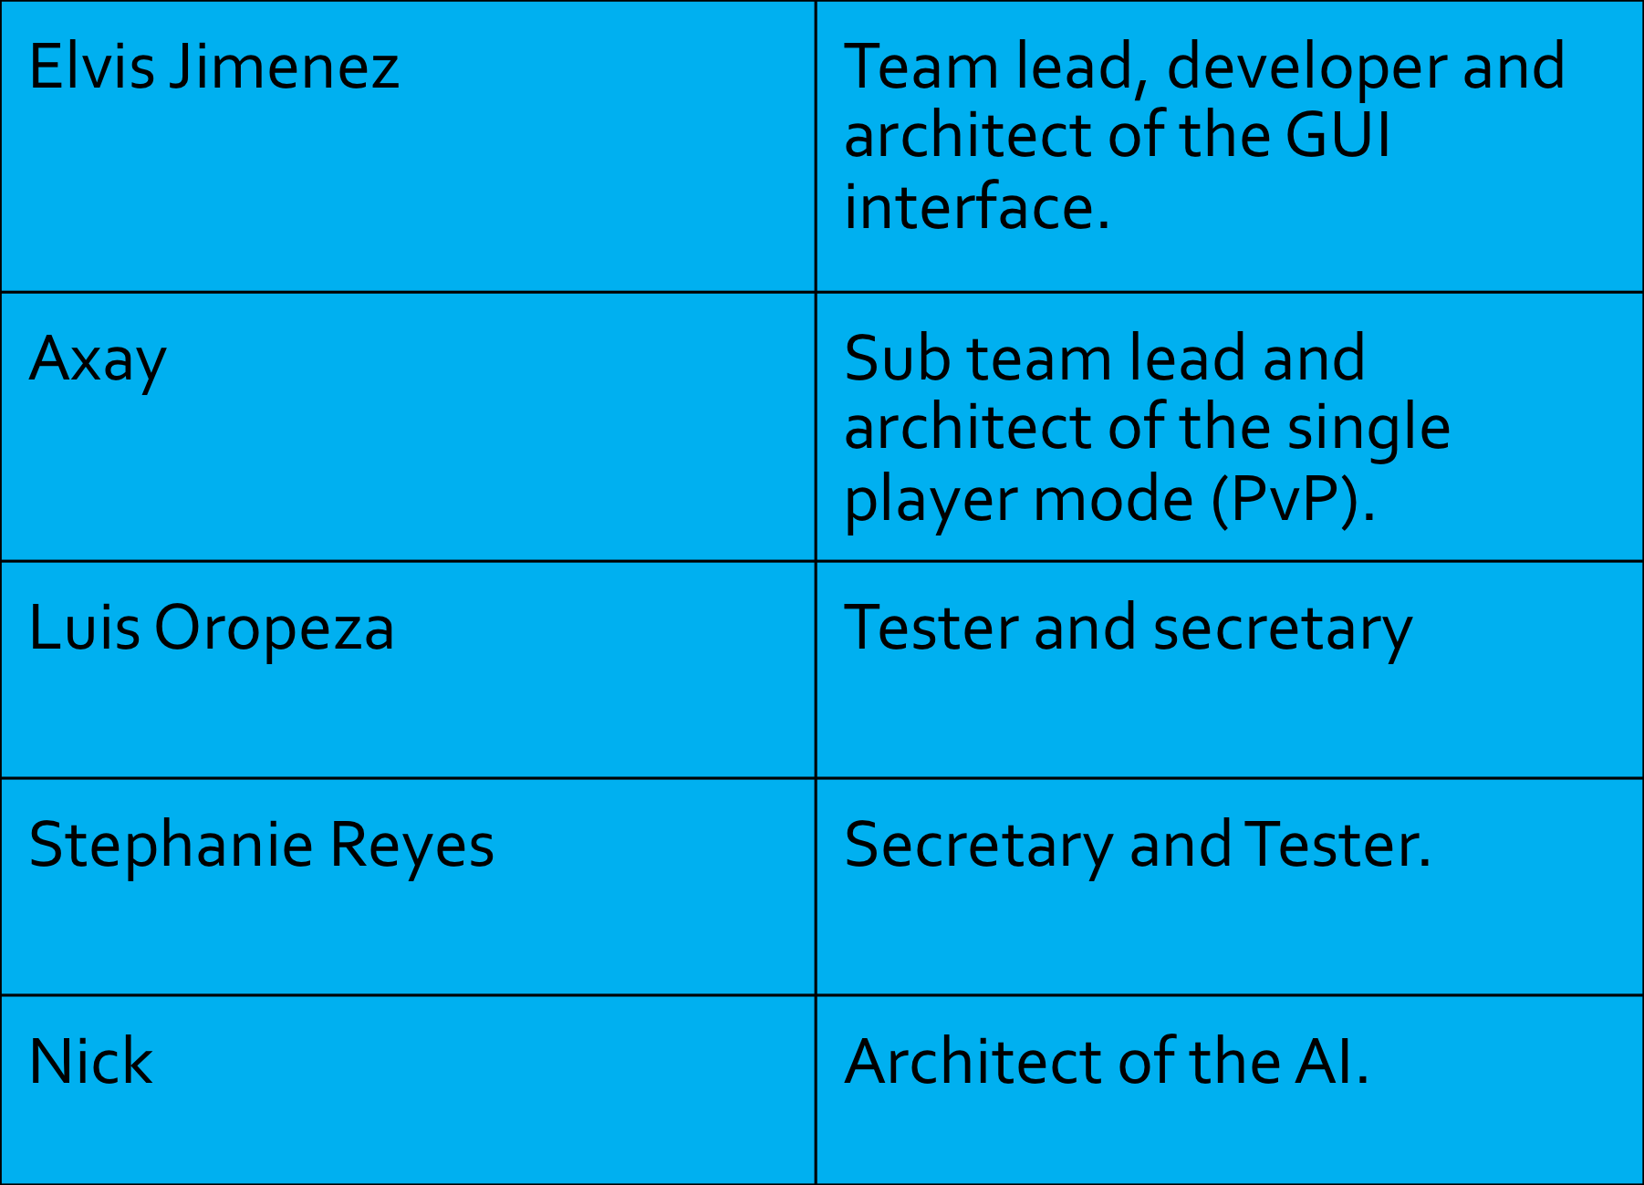
Team Composition

Slide 3
Objectives
Develop testing strategies
Conduct testing plans with documentation logs
Deliver a product to client that meets requirements and remains within projected costs.
Submit functional product and documentation by deadline

Slide 4
Modification History
Modification History since last presentation to client on 11/1/16:
Modified UML Class Diagram
Included hard difficulty level
Functional player registration
Included player score history
Testing Plan Documentation
Expanded detailed steps on requirements
Elaborated scenario descriptions
Reevaluated COCOMO model for resource allocation

Slide 5
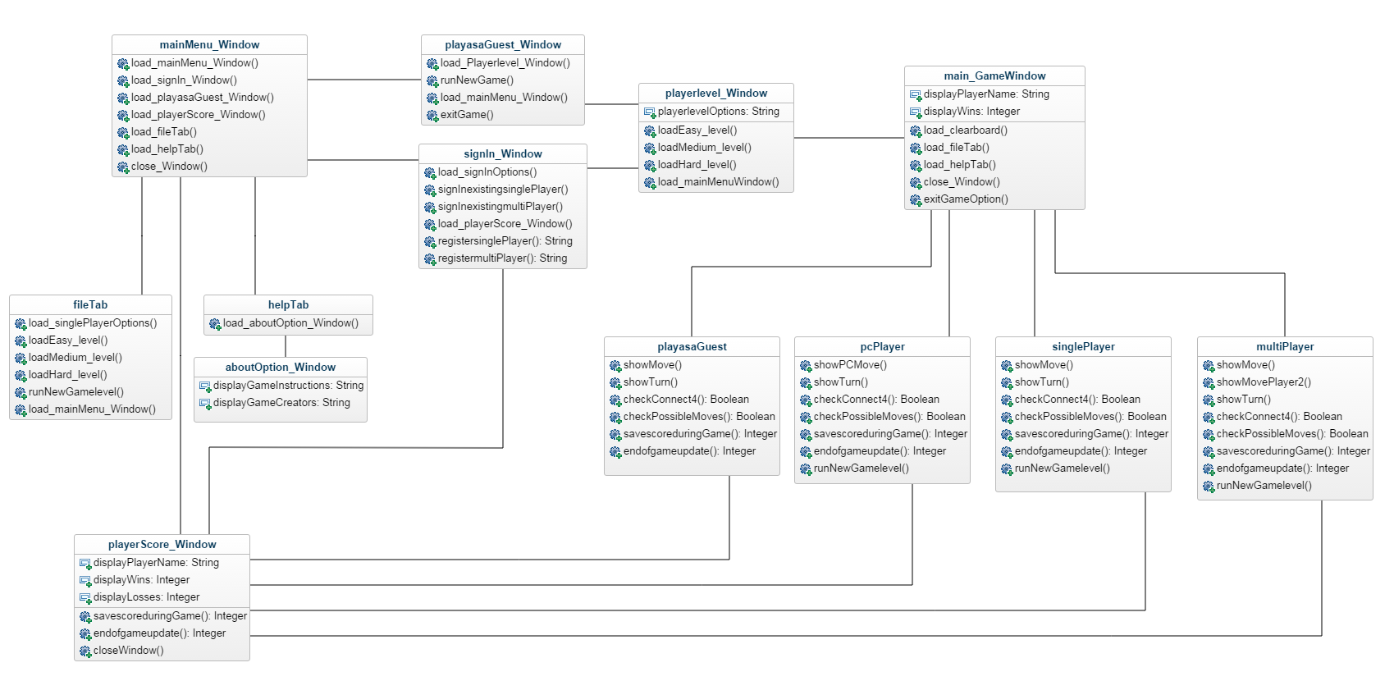
Modified UML Class Diagram

Slide 6
Testing Plan
Objectives of execution-based testing:
Test prototype for reliability and performance
Testing the integration of embedded systems in the prototype
The embedded features among the following systems will be tested:
Sign In
Register Player
Difficulty level selection
Single Player New Game
Multiplayer New Game
Player Scores
Exit Game

Slide 7
Types of Testing
System Testing
Interface Testing
Integration Testing
Regression Testing
Component Testing

Slide 8
System Testing
TEST STRATEGY FOR LOGIN AND SIGN-UP
This module will be tested against all test cases .
Input: valid username, invalid username, repeated usernames, unique usernames.
TEST STRATEGY FOR SINGLE-PLAYER MODE
The efficiency of AI to predict correct moves will be tested.
Inputs: three stones in a row, four stones in a row, empty rows, five stones in a row, one stone in a row, two stones in a row
TEST STRATEGY FOR MULTI-PLAYER MODE
Inputs: Player inputs empty name, Player plays as a guest, player is a registered user, player goes first, player goes second.
TEST STRATEGY FOR LEVEL DIFFICULTY
Inputs: difficulty level easy, difficulty level medium, difficulty level hard
TEST STRATEGY FOR UPDATE/RETREIVE SCORES
The reliability of the database will be tested.
Inputs: Push invalid data to database, push valid data, retrieve history for invalid users, retrieve history for valid users.

Slide 9
Interface Testing
Interface Testing: Testing all window panels for user display
Main Menu Window: Gives player options
About Window: display the instructions and game creators
Sign in Window: uses player credentials to play and save score
Register Window: registers player name
Score Window: displays history
Difficulty level Window: player selects level
Game Window: display the initial grid of size 5X5
Exit: the game will be closed.

Slide 10
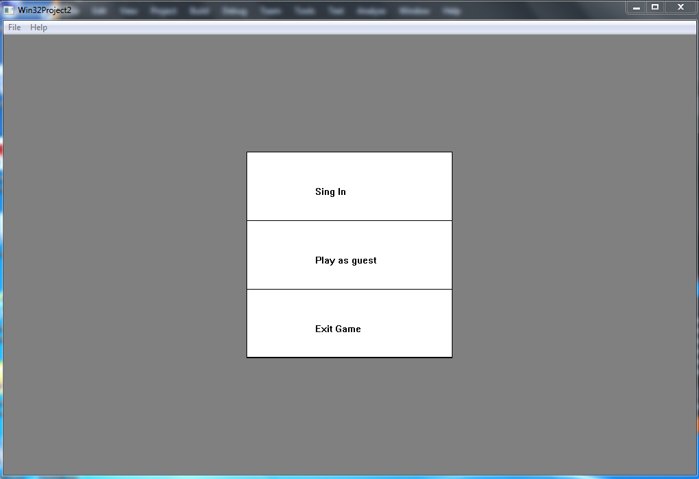
User Menu Interaction

Slide 11
Integration Testing
Integration testing: Testing a group of methods together that have been unit tested
Sign in: uses player enters credentials to play and save score
Register: registers player name .
Play as a guest new game: begins new game without credentials
Multiplayer new game: begins game for two players
Single player new game: begins game for single player with AI
Difficulty level: player selects level
Score: displays history
Save Score: updates score when 4 are connected
File tab: user options
Help tab: gives about option for instruction display
Exit: the game will be closed.

Slide 12
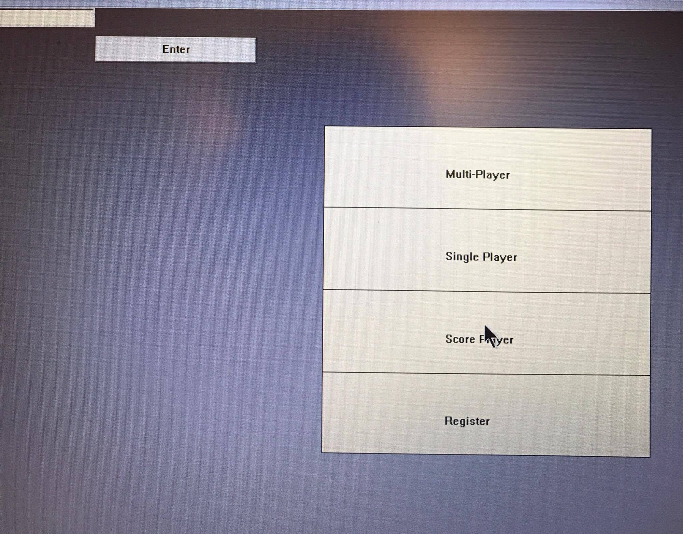
User Options Interaction

Slide 13
Regression Testing
Regression testing: Testing modified implementation to make sure the program still works with the new changes.
Test fixed bugs promptly.
Write a regression test for each bug fixed.
Identify tests that the program consistently passes and archive them.
Make changes (small and large) to data and find any resulting corruption.

Slide 14
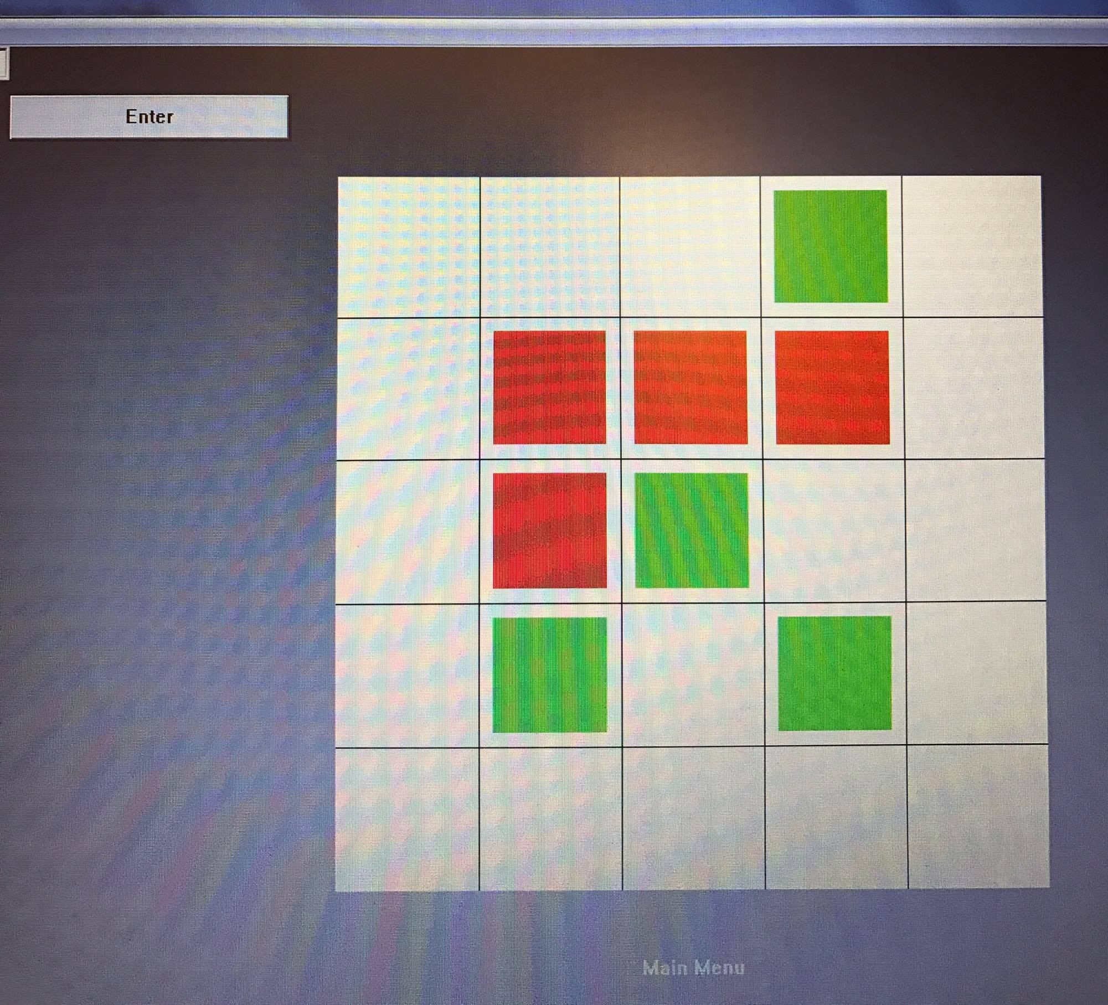
Game Interface

Slide 15
Component Testing
Windows Operating System: Win XP /vista/7/8.0 or higher
Software: Visual Studio 2015
Software Testing Techniques:
Statement testing
Block testing
Hardware: Processor : Intel® Core™ i5-4700MQ CPU @ 2.00 GHZ. RAM: 1.00 GB or Higher
System Type: 32- bit or higher Operating System , x86-based processor or higher.
Notes:
Statement Testing: Testing to satisfy the criterion that each statement in a program is executed at least once during program testing
Block Testing: testing to satisfy how many blocks have executed

Slide 16
Risk Management Plan
The team lead and secretary will be testing the implementation of the algorithm.
SQA will be testing source code functionality.
Length: 3 weeks
Team Composition Testing Requirements:
Personal Computer
Visual Studio 2015
Github
Emails
Weekly Meetings

Slide 17
Criteria
Passing Criteria: Every primary use case must be successful for the application to pass. If any test associated with a primary use case fails, the system test fails.
Suspension Criteria: Tests will be sequenced to exercise progressively more of the system. Testing will be suspended when program faults prevent the tester from moving further into the system.
Resumption Criteria: After analyzing the source of errors and corrected fixes have been carried out; testing will be resumed.

